Slide 1

OpenAI API
Getting
Started
Notes:
https://gemini.google.com/app

Slide 2
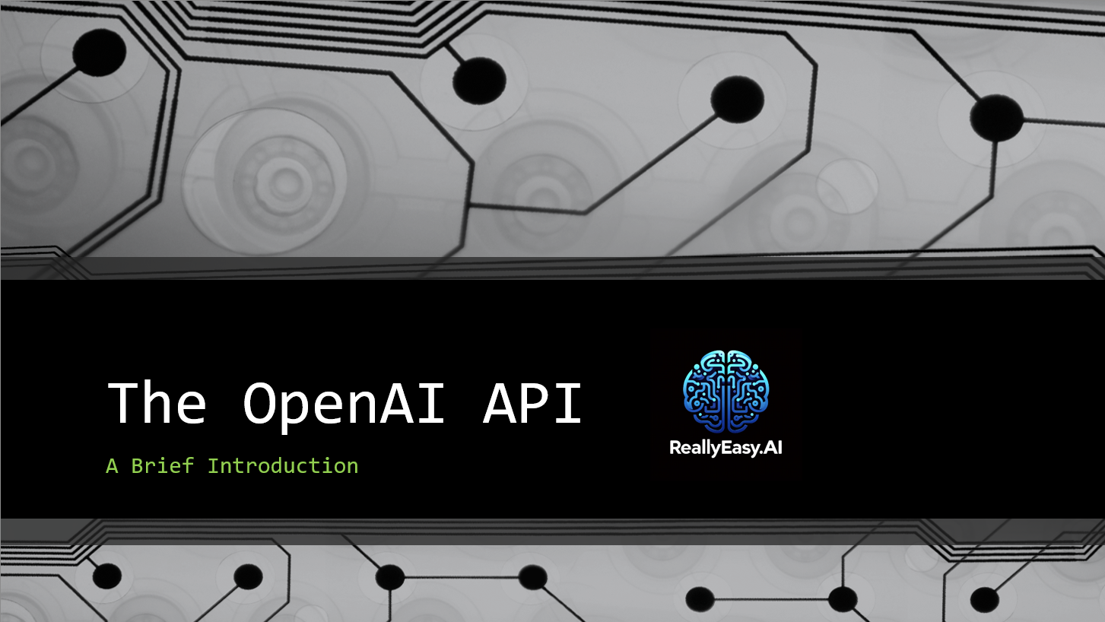
2/4/2024

Slide 3
What is an API?

Slide 4
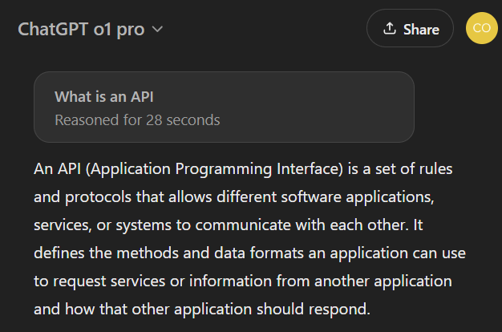

Slide 5

Notes:
https://www.postman.com/

Slide 6
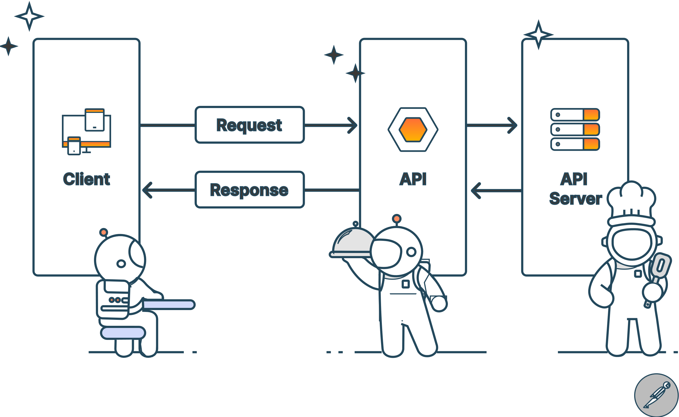
Notes:
https://www.postman.com/what-is-an-api/

Slide 7
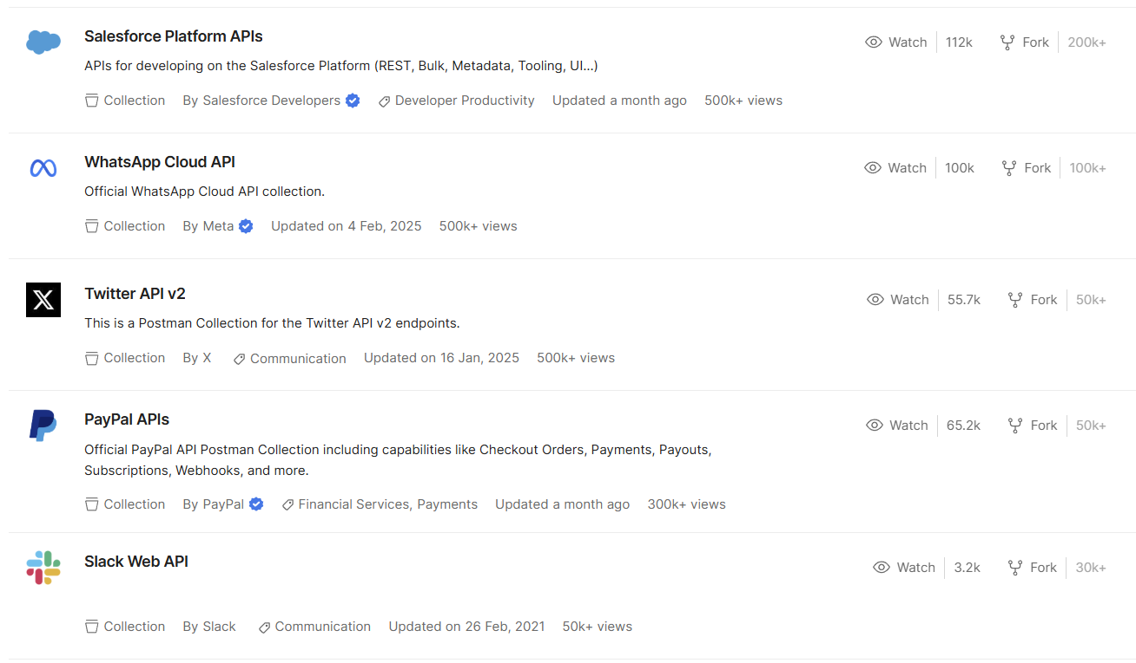
Notes:
https://www.postman.com/explore

Slide 8
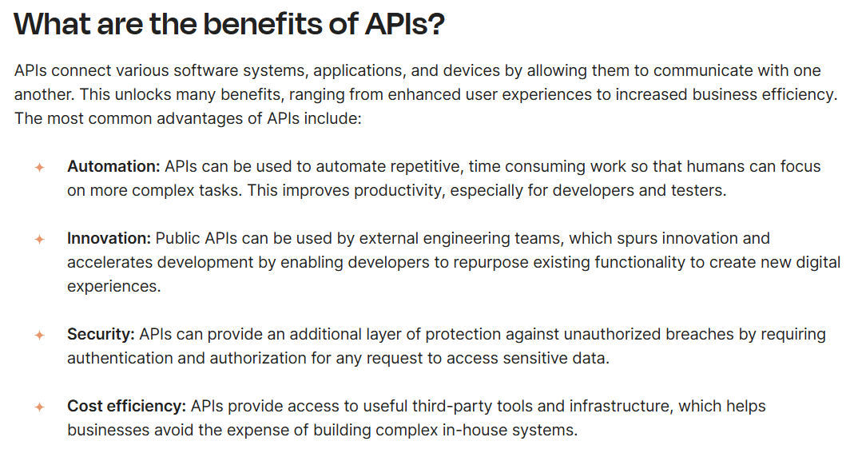
Notes:
https://www.postman.com/what-is-an-api/

Slide 9
DEMO: Postman API Catalog
Notes:
https://www.postman.com/explore

Slide 10
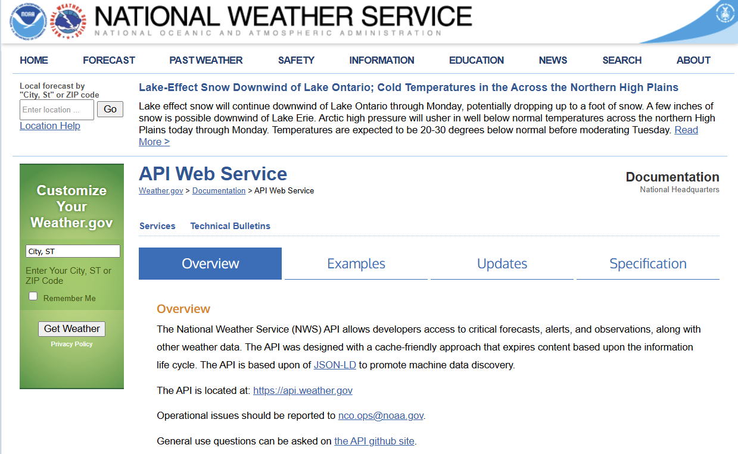
DEMO: Weather API
Notes:
https://www.weather.gov/documentation/services-web-api

Slide 11




Notes:
https://www.youtube.com/channel/UC35ZpwldGw7ZJ5R-2sLijzw

Slide 12
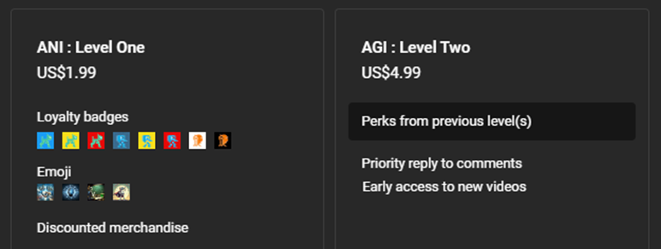
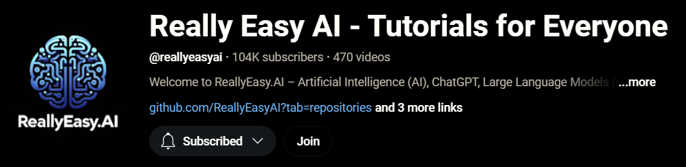
Notes:
https://www.youtube.com/@reallyeasyai/join

Slide 13

https://shop.reallyeasy.ai
Notes:
https://shop.reallyeasy.ai

Slide 14

https://www.youtube.com/@ainewsfresh
Notes:
https://www.youtube.com/@ainewsfresh

Slide 15

https://www.youtube.com/@aipaperspodcastdaily
Notes:
https://www.youtube.com/@aipaperspodcastdaily

Slide 16
The OpenAI API

Slide 17
Models
o3 o1 GPT-4o GPT-3.5
Services
API Endpoints
Sora Operator DALL*E TTS Whisper
Packages
ChatGPT Sora Operator DALL*E
Embeddings Moderation GPT Base
/v1/chat/completions /v1/assistants /v1/embeddings
Python Javascript .NET Java Golang

Slide 18
Getting Started with OpenAI

Slide 19
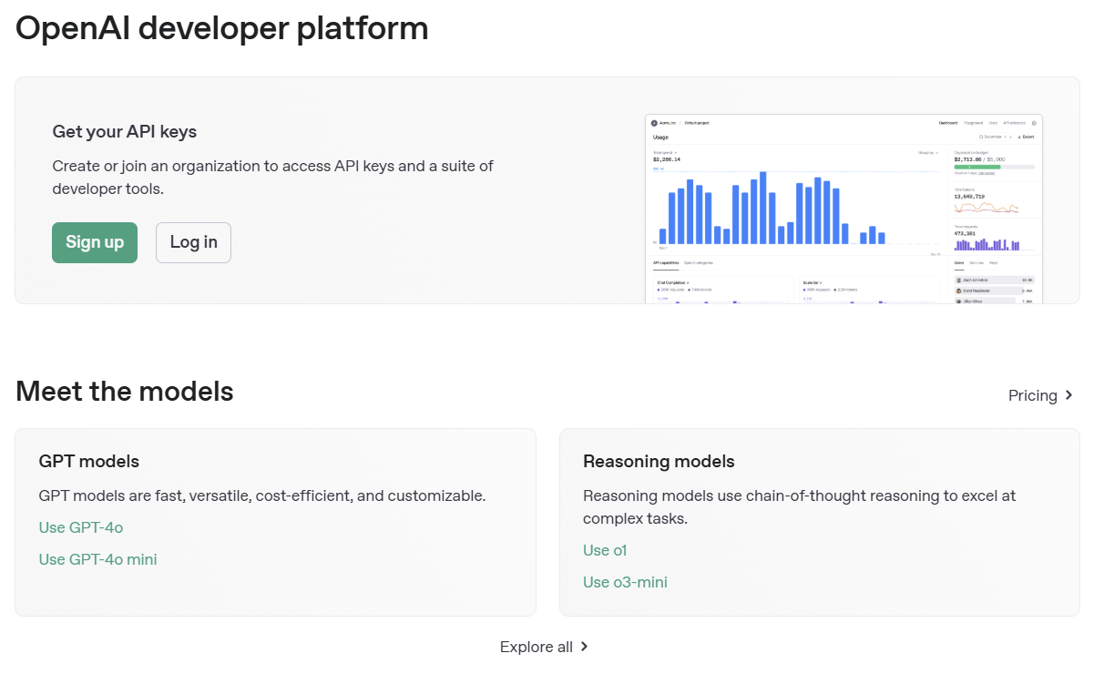
Notes:
https://platform.openai.com/

Slide 20
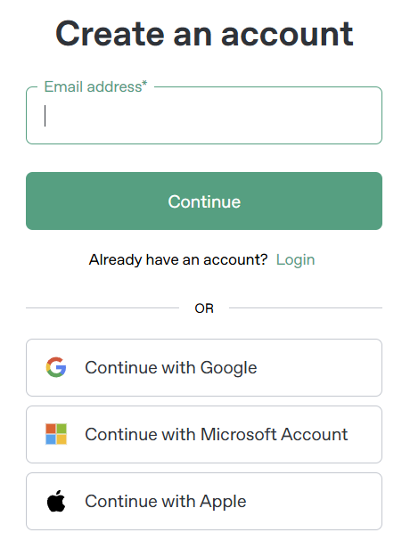
Signing Up

Slide 21
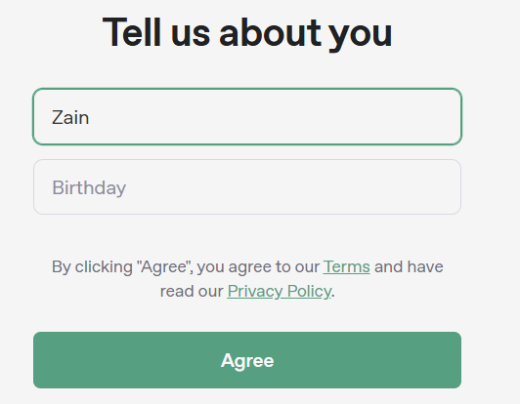

Slide 22
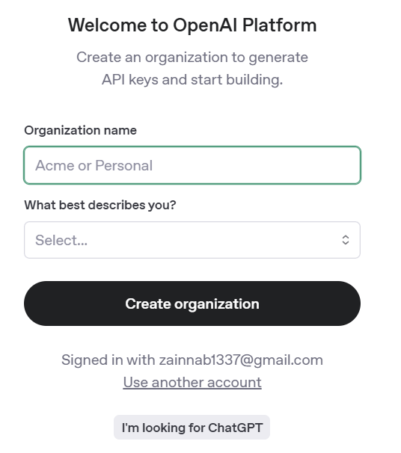

Slide 23
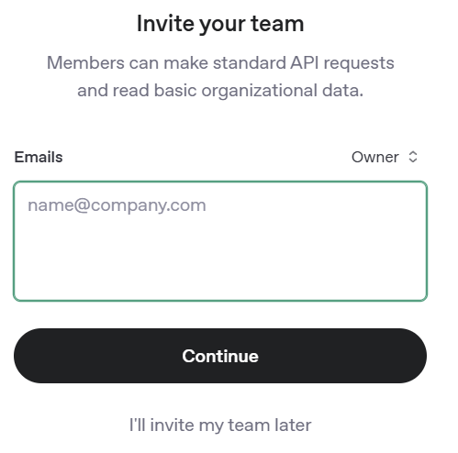

Slide 24
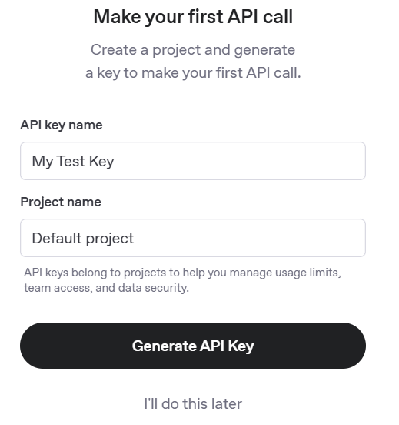

Slide 25
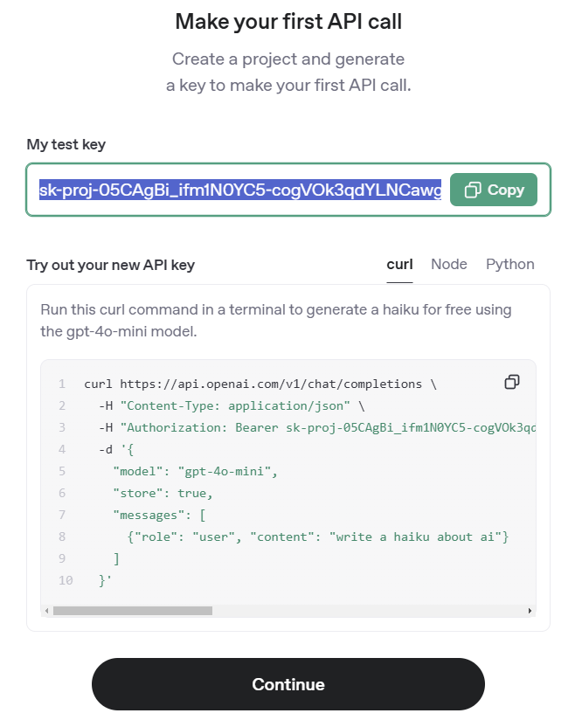

Slide 26
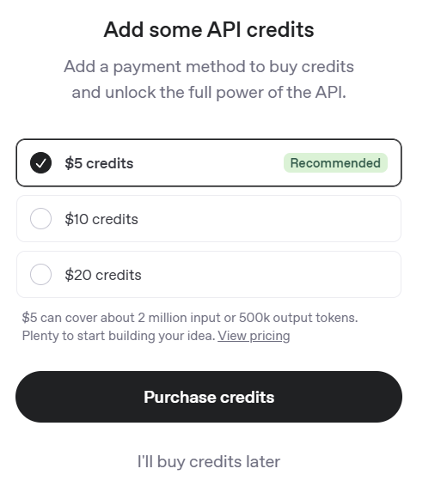

Slide 27
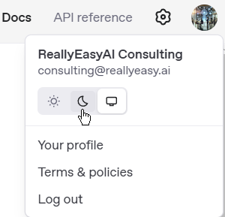
Switching to Dark Mode

Slide 28
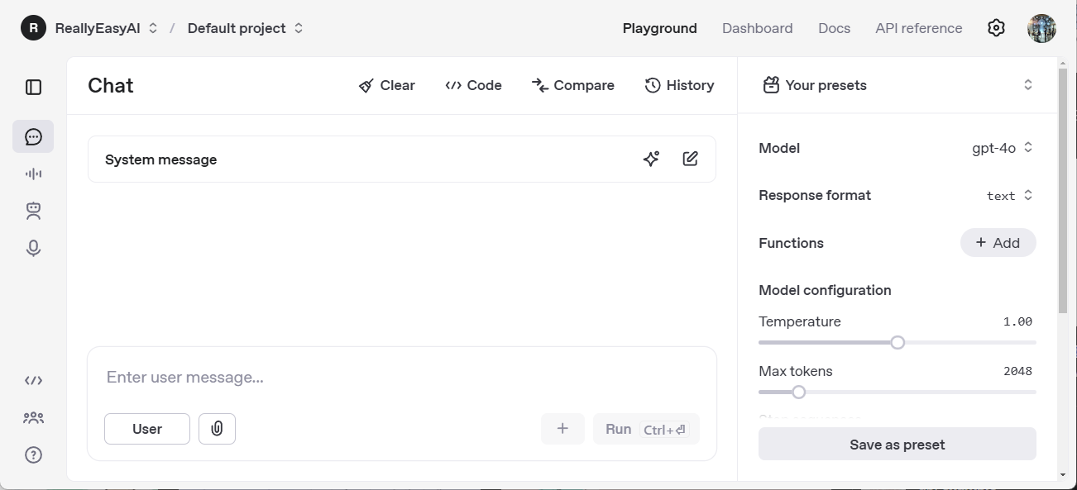

Slide 29
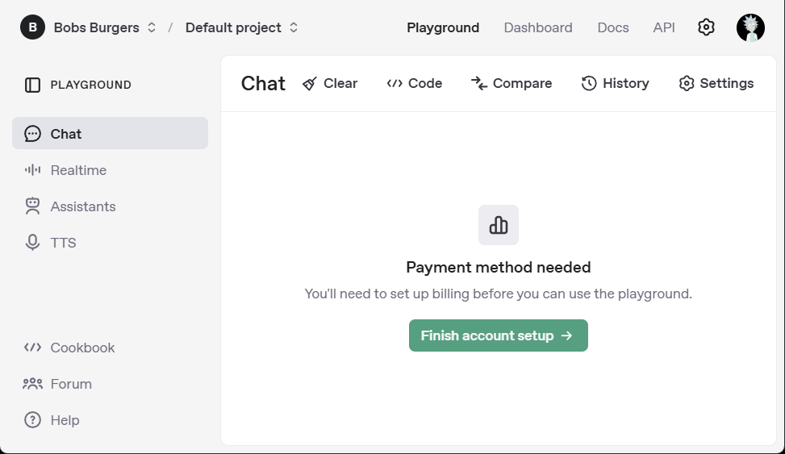
Can’t Use the Playground without Billing

Slide 30
DEMO: Using the Chat API

Slide 31
Exploring the Settings

Slide 32
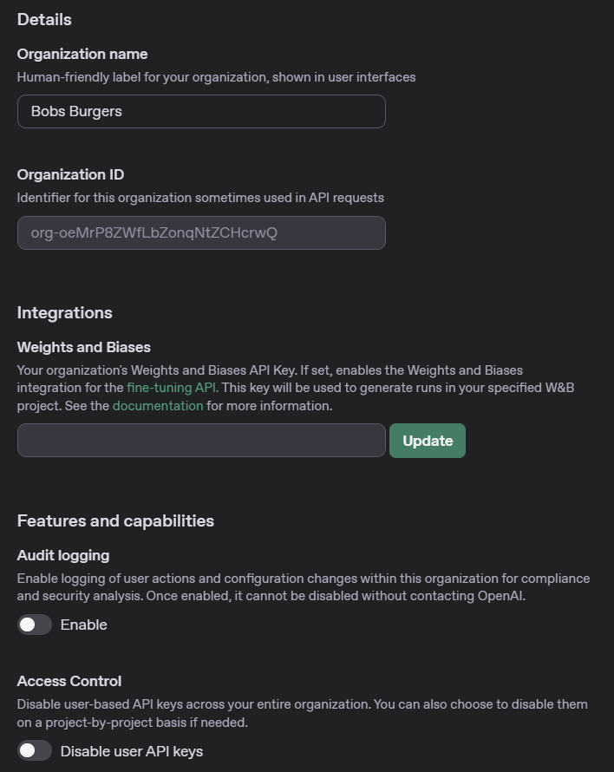
Organization General

Slide 33
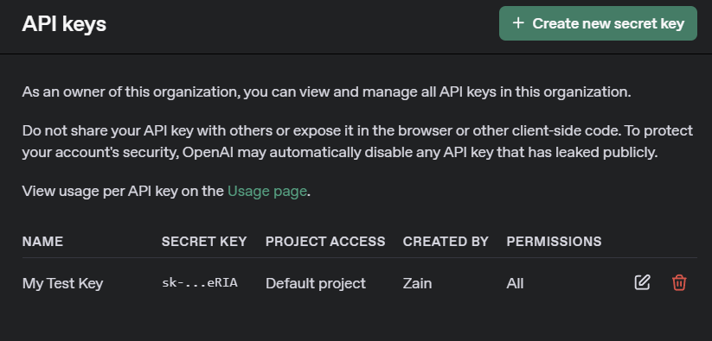
Organization API Keys

Slide 34
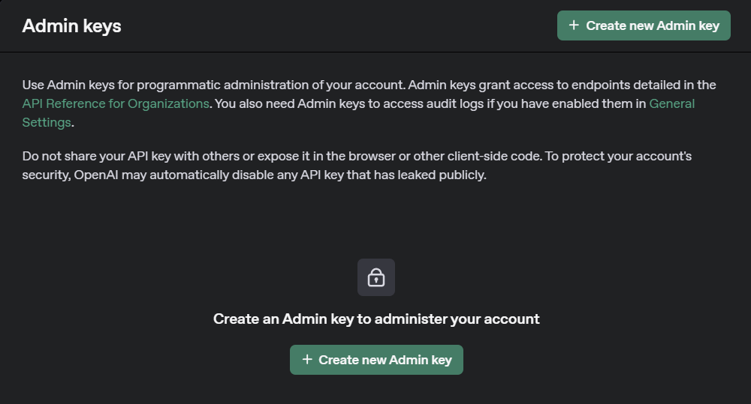
Organization Admin Keys

Slide 35
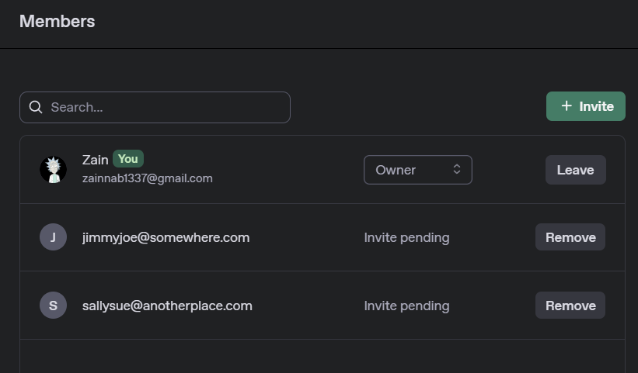
Organization Members

Slide 36
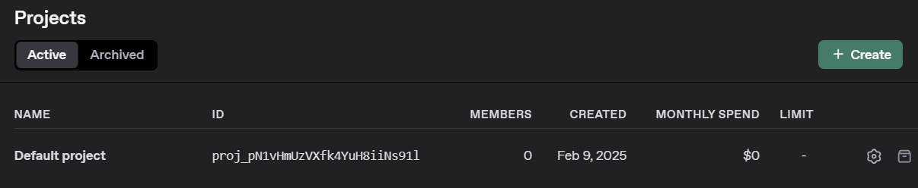
Organization Projects

Slide 37
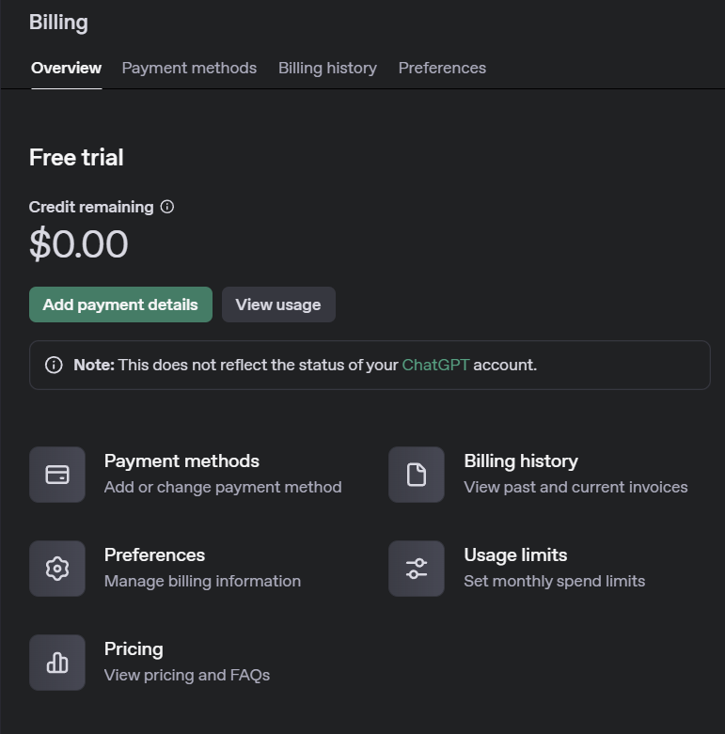
Organization Billing

Slide 38
Rate Limits Explained
TPM stands for "Tokens Per Minute." This is the maximum number of tokens you can send or receive within a one-minute window.
RPM stands for "Requests Per Minute.“ This is the maximum number of API calls (requests) you can make in a one-minute window.
RPD stands for "Requests Per Day.“ This is the maximum total number of API requests you can make over a 24-hour period.
TPD stands for "Tokens Per Day.“ This is the total token volume you are allowed over a 24-hour period.

Slide 39
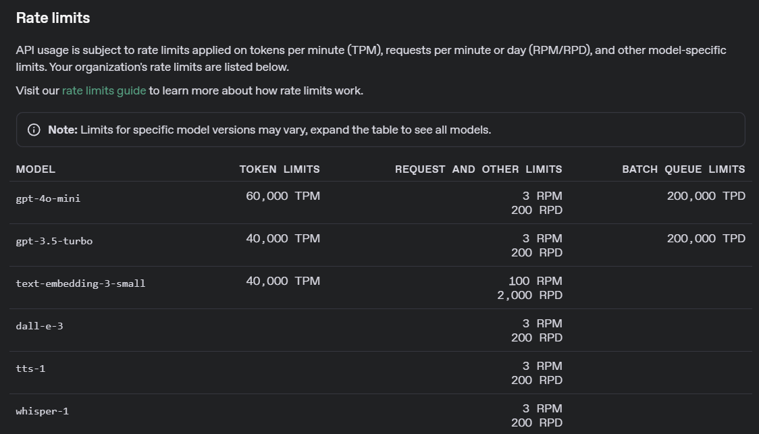
Organization Rate Limits (Free Tier)

Slide 40
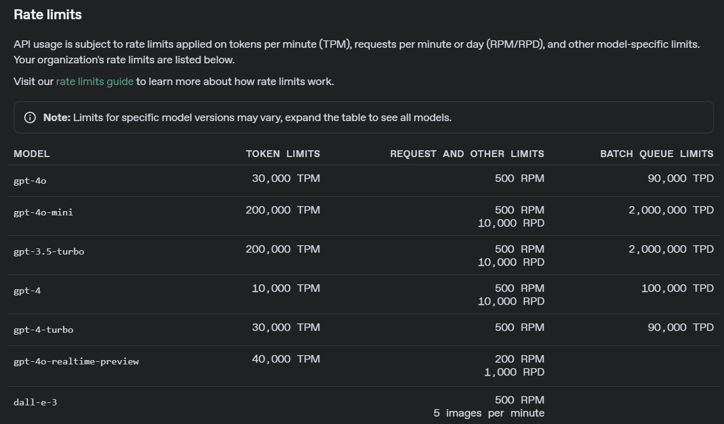
Organization Rate Limits (Tier 1)

Slide 41
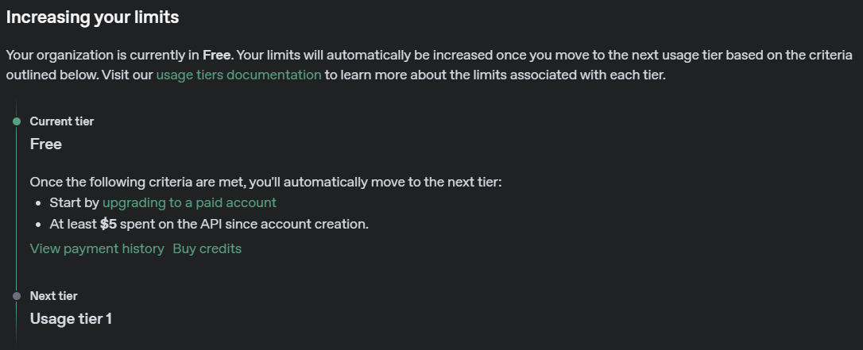
Organization Rate Limits Upgrade (Free Tier)

Slide 42
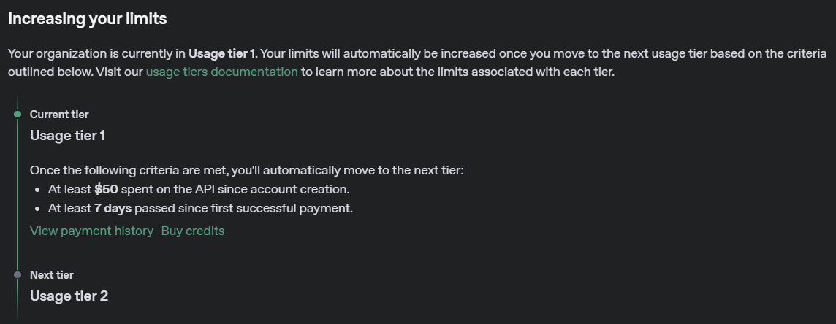
Organization Rate Limits Upgrade (Usage Tier 1)

Slide 43
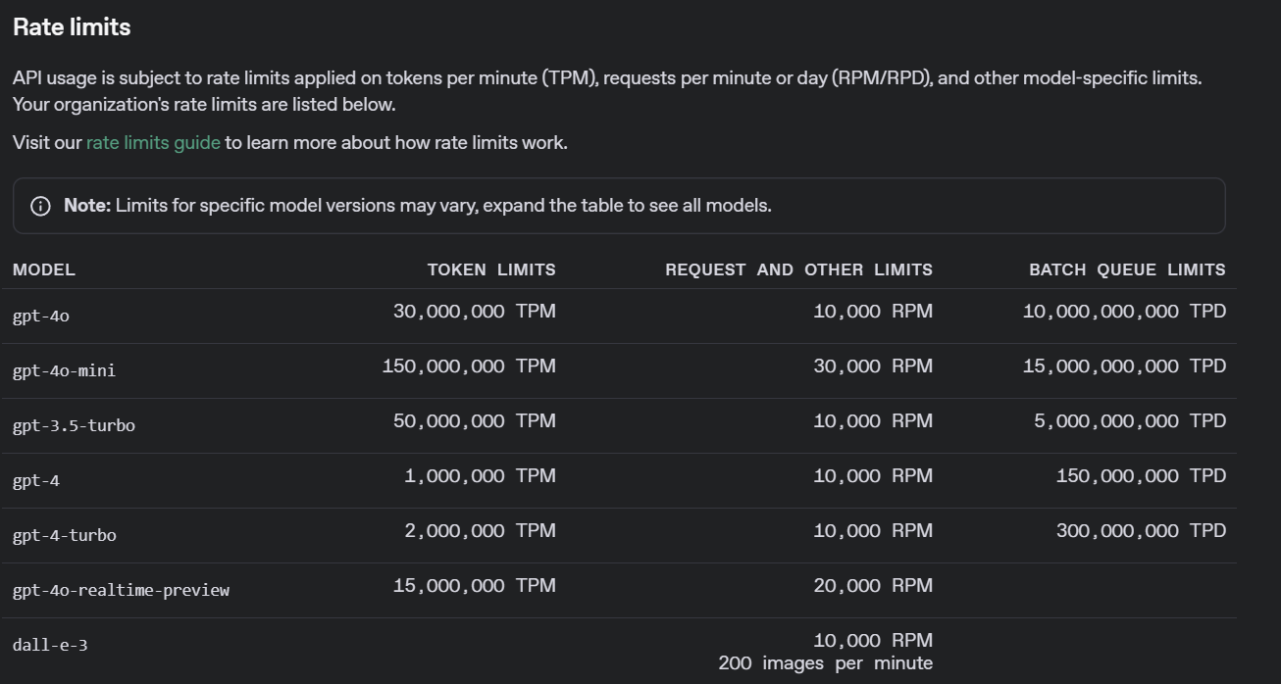
Organization Rate Limits (Usage Tier 5)

Slide 44
Organization Rate Limits Upgrade (Usage Tier 5)

Slide 45
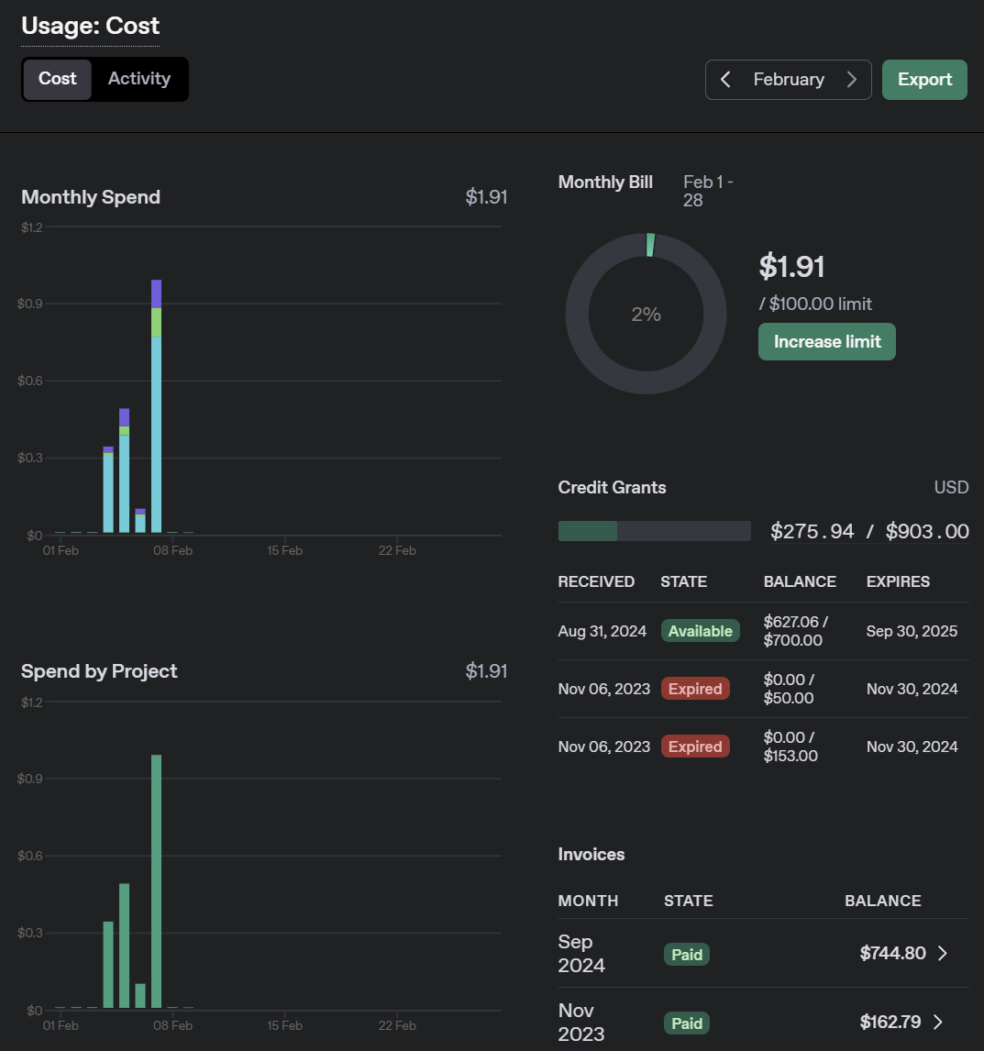
Organization Usage

Slide 46
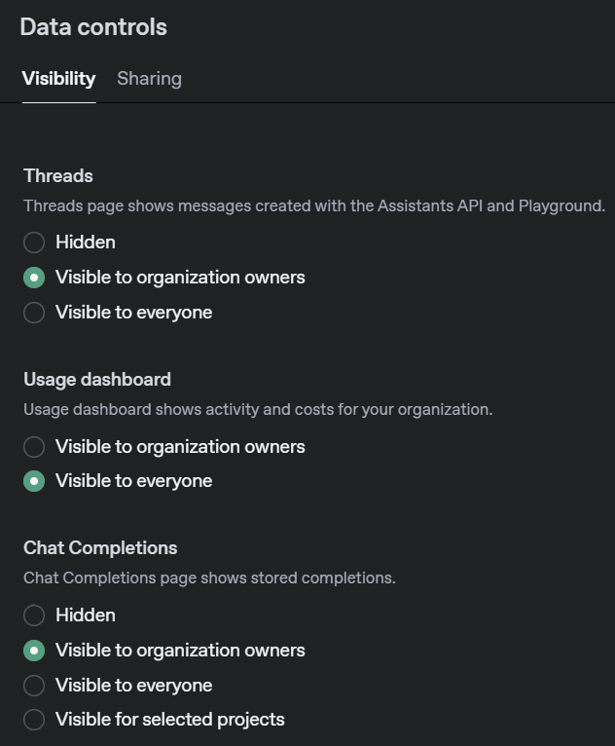
Organization Data Controls (Visibility)

Slide 47
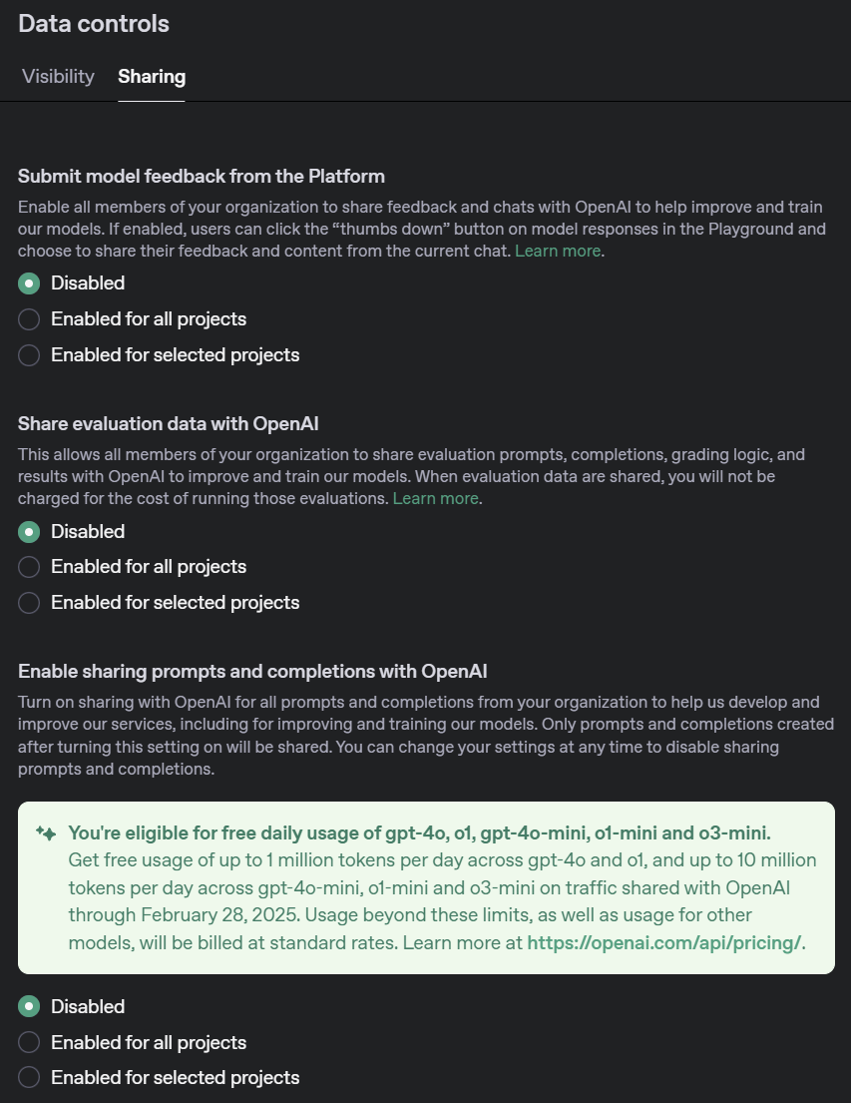
Organization Data Controls (Sharing)

Slide 48
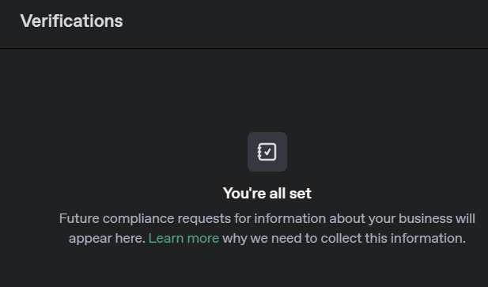
Organization Verification

Slide 49
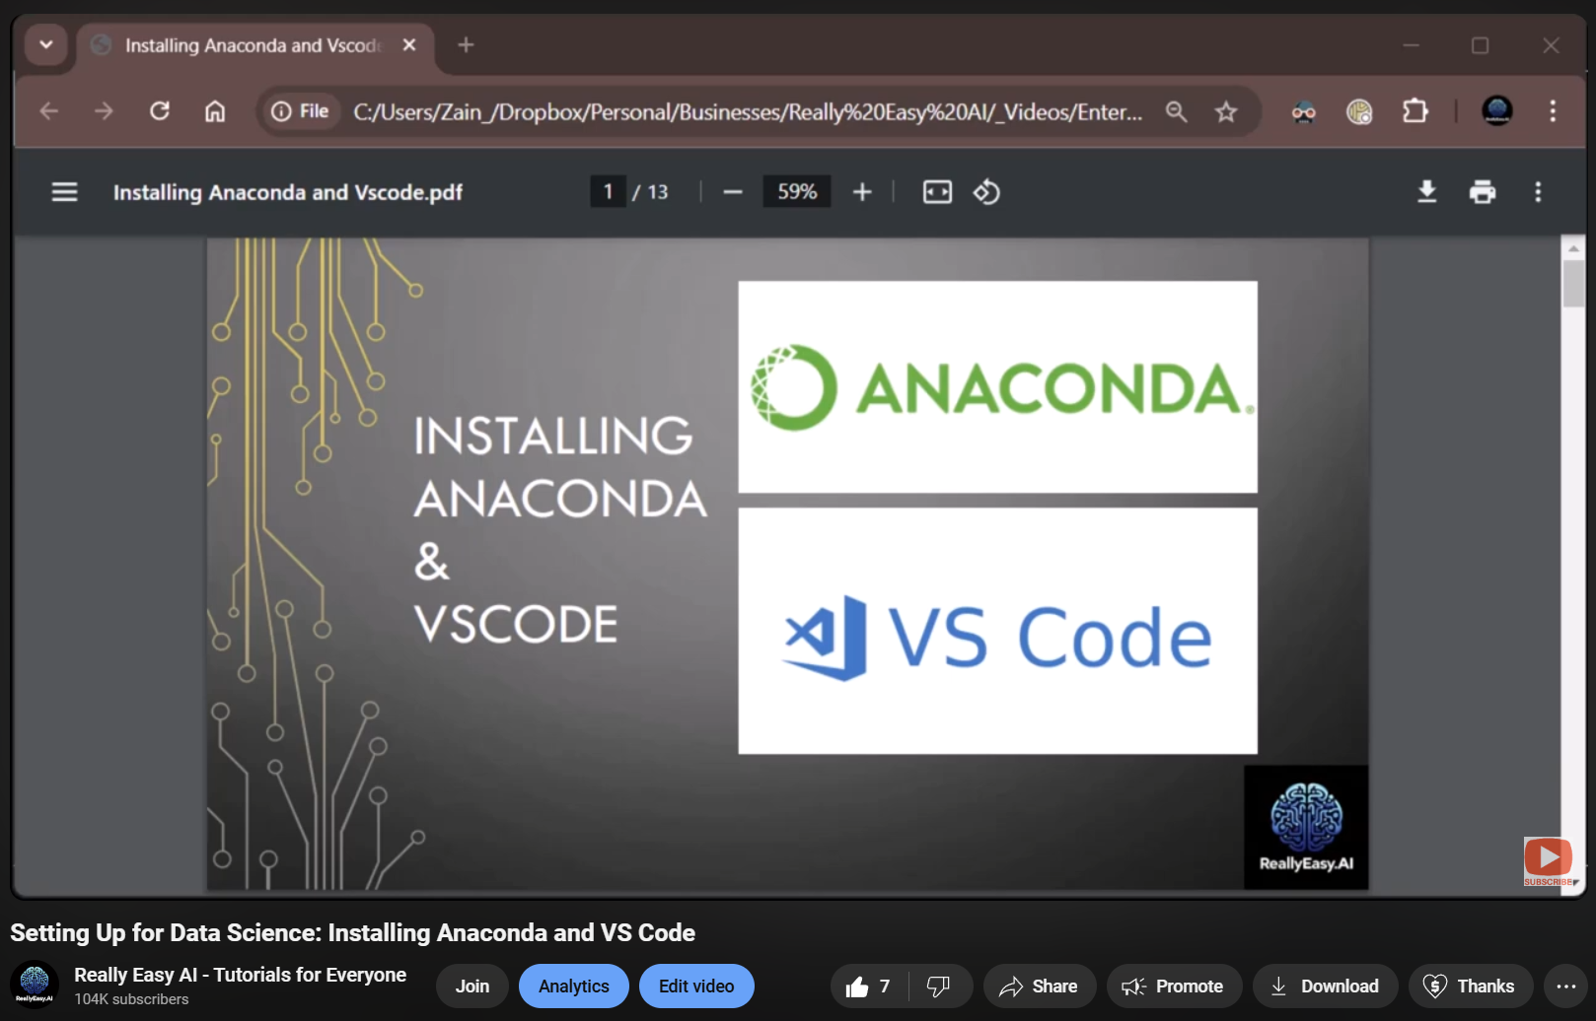
Setting up Anaconda and VS Code
Notes:
https://www.youtube.com/watch?v=50TM9pfYv5U

Slide 50
OpenAI API
Getting
Started
Notes:
https://gemini.google.com/app

